Slide 1
Workbook Expenses – TCM (Historical)
Internal Use Only
April 2017
EXCEL FILE:

Slide 2
Disclaimer
The content of this workbook has been produced by KPMG Germany/Deal Advisory on the basis of German accounting standards and/or IFRS, as well as considering KPMG Germany’s firm and country requirements, regulations, processes, policies and best practices. Please check your local accounting and other requirements before applying the content.

Slide 3
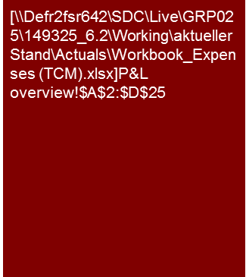
Overview (1/2)
Flag: The workbook contains examples of income statements prepared by the Total Cost Method, which is commonly used in the DACH region. Check your local GAAP requirements before applying TCM in your analysis.
Benchmarking Plus tool is available in Germany. Please ask for benchmarking options in your region.
Expenses – Total Cost Method (historical)
Mission Statement:
Understand the trends and drivers for the costs below gross margin in the historical period.
Customer situation
Definition/Methodology/Tools of the basis analysis
Buy Side/Sell Side/JV/Turnaround
Costs below gross profit will have a significant influence on the profitability of the target entity. Analysis of historic costs to form a view on underlying earnings and respective projections in the business plan requires a thorough understanding of the relevant cost drivers.
Integral policies
This workbook covers the costs below gross margin which would normally include:
Personnel expenses;
Other income/expenses; and
Depreciation.
Interest and taxes are not part of EBIT(DA), but may be analyzed more closely in certain cases.
Ideally the TCM cost analysis will be performed by function (e.g. manufacturing, selling and distribution, admin, etc.). This will combine a costs by nature (TCM) and costs by function (CoS) view, but requires an understanding as to how costs are being allocated to functions (insights into cost center structure and allocation keys, e.g. whether production overhead is shown as manufacturing or as admin costs).
Especially for larger groups meaningful cost and cost driver analysis typically benefits from a drill down by Business Unit (segment), by region or by legal entity, rather that analysis of consolidated group figures only.
General data sources:
Audited financial statements;
General ledger;
(Monthly) management reporting and other controlling reports.
Degree of Standardization
Such analysis is relevant across all Deal Advisory functions and should be linked to workbooks 'Sales and Gross Profit (Historical)', 'Sales and Gross Profit (Planning)', 'Normalized Earnings” and “Provisions'.
Gathering of sector-specific KPIs (e.g. KGS Benchmarking Requests, Benchmarking Plus Tool).
Note: In a P&L table expenses should be presented with negative.
Breakdowns of cost items may be presented in positive or negative numbers, but the latter reduces the likelihood for errors with leading signs, especially when details to the P&L overview. For % of sales we recommend using positive signs even for cost items

Slide 4
Overview (2/2) – Structure of analysis (Total Cost Format) and related workbooks
Expenses – Total Cost Method (historical)
High level P&L analysis
Workbooks for detailed analyses – Value Driver Tree
Commentary
Explanation of key trends (sales growth, profitability in % of sales, significant shifts in individual P&L lines), if necessary supplemented by individual operational KPIs and/or benchmarks; depends strongly on business model and sector of the specific company
Purpose of high level P&L analysis:
Planning of our work: determine key areas of focus for detailed analyses
Reporting: Provide a Big Picture Overview on Target's financial performance and a summary of key trends observed
Workbook ”Sales and Gross Profit"
The detailed analyses should
improve our understanding of the business model
show trends in financial performance (monthly or quarterly as appropriate)
identify sales and profit drivers by an appropriately detailed analysis (by product group, customer, etc.) and provide respective benchmarking
form the basis for the Business Plan / analysis of projections (→ starting point for financial model)
Market development
Sales
x
Price
Gross Profit
Trend analysis (with KPIs)
Volume
-
Differentiated according to product groups, customers, regions (as applicable)
Margin (in % of sales)
Costs of materials
Price
By type of materials
x
EBIT
Volume
-
Workbook “Expenses Total Cost Method"
Personnel costs
Headcount (FTEs)
Differentiated according to functions (production/storage, R&D, sales, administration)
x
Level of remuneration
Expense items below gross profit
Analysis aims at making cost structure and drivers transparent
Other expenses (+ earnings)
Trend analysis by type of expense
e.g. yoy growth, in % of sales, per sqm rental space, etc.
Fixed vs. variable and cost drivers
Workbook “Fixed assets – CAPEX"
Trend in relation to CAPEX
Impairments
Useful life and if necessary changes in accounting principles
Depreciation
Workbook “Normalized Earnings"
The goal is to understand the underlying profitability
Adjustment of the historical earnings for "one-off effects" that are not relevant for the future development.
One-off effects

Slide 5
Pitfalls and lessons learned
Expenses – Total Cost Method (historical)
No. | Specific analysis
 | Lack of focus on value drivers: The analyses should be focused on the major value drivers. For example it is frequently more important to provide sufficient granularity around personnel expenses (by function, by region, etc.) and respective cost drivers (headcount, pay levels, in-/ outsourcing, productivity/utilization) rather than obtaining insights into sundry other costs (especially if the latter are not volatile).
 | Inconsistencies compared to the Business Plan: Format: Often we have to work with different data sources for historic and protected financials (e.g. annual report versus controlling data). This can cause problems for our (like for like) trend analysis unless we perform a consistent mapping of line items over the entire period (e.g. temporary/ subcontracted labor consistently within personnel or within other expenses). Therefore you should familiarize yourselves with the business plan format before you start detailed historic analysis. Recurring: Expense analysis should aim at establishing a recurring level for each type of expenses (a robust base year to be used as a starting point for the business plan analysis). Whenever we come across significant one-off effects (→ “Normalized Earnings” workbook) we should consider to adjust our historic cost analysis on a line by line basis (rather than only presenting the net EBITDA effect of adjustments). This is typically most prominent for other income, simply because the recurring level of other income is generally low, so that even small distortions by non-recurring income items will be highly visible).
 | Lack of sufficiently detailed cost information: For international groups our cost analysis will necessarily be based on consolidated financial statements. Meaningful trend analysis and benchmarking for other operating expenses requires breakdowns of such expenses into sub-categories. The availability and reliability of such breakdowns will depend on the “accounting discipline” throughout the Group (global chart of accounts and accounting/costing manual being monitored/enforced across the Group) “other cost” analysis. A workaround may be to use breakdowns by legal entity / reporting unit and to understand cost drivers on that level.
 | Lack of focus on current trading figures: Analysis of current trading information is often left until shortly before issuing a report, and then presented in a separate report section. The benefit is that we do not need to update the entire report for most recent numbers, and that we can accommodate the typically lower granularity of current trading figures compared to annual reporting. However, for relevant cost items we should enquire into most recent trends to double check our understanding regarding the respective cost drivers and trends.
 | Unsuitable benchmarks: Benchmarking is extremely valuable to challenge our understanding of a company’s business model and cost drivers. However, it is a very ‘high level’ type of analysis, and especially in a TCM format P&L typically limited to personnel cost ratios and EBIT(DA) margins, because more detailed breakdowns of e.g. other cost will often not be available in a like for like format. Make sure that you understand relevant differences between companies in the peer group, e.g. for haulers or airlines with owned versus leased fleets.
1
2
3
4
5

Slide 6
Core issue (1/3)
Expenses – Total Cost Method (historical)
Core Issue | Specific analysis | Page(s)
What are the primary costs (and the respective cost drivers) ? | Prior to any in depth analysis of individual cost items rank them by magnitude and consider their impact on bottom line profitability (e.g. in a €1bn revenue business, you should probably not spend much time on analyzing €1m ‘other’ costs, especially if the respective amount does not fluctuate significantly). A key problem of cost analysis following the total cost method is to identify the profitability impact from e.g. own R&D activities or central overheads (e.g. group-wide purchasing and/or marketing for a retail chain, which may or may not be allocated to individual retail stores). The challenge will often be to supplement a TCM view by CoS type of analysis, e.g. personnel costs by function. Tailor your analysis to the respective business model and industry specifics, e.g. For a professional services firm, focus on personnel costs and respective metrics (headcount by grade, utilization, churn/attrition rate, fix vs. variable pay, ageing, etc.) For an airline distinguish between direct operating costs ("DOC" such as fuel, airport charges, selling and advertising) versus rather fixed ACMI cost (aircraft, crew, maintenance and insurance); and e.g. for personnel between flight deck, cabin, maintenance, ground handling and sales/admin. Align the structure of historic cost analyses to the Planning workbook, i.e. what drivers are used in the Business Plan to drive the cost base (e.g. rent for a retail company based on the number and floor space of stores, ownership versus leasing, rent indexation and potentially turnover related incremental lease rate elements). | 9-13

Slide 7
Core issue (2/3)
Expenses – Total Cost Method (historical)
Core Issue | Specific analysis | Page(s)
Trends and cost drivers of the primary costs Do costs increase proportionally to sales? (How) will the cost structure change going forward and what are the implications on the valuation and the business plan? | Trend analysis (year on year, monthly or moving average) of expenses as applicable in absolute terms or as a percentage of sales. Analysis of the cost structure (fixed, variable, semi-fixed costs) Ratio analysis combining financial and non-financial KPIs, IT costs per employee, marketing costs per signed order / subscriber acquisition costs per contract Consider potential changes to the cost structure, e.g. in- and outsourcing / ‘make or buy' decisions; use of own workforces versus temporary labor, shift from equipment sales to after sales services, etc. Examples of specific analyses: Personnel costs: Bridge considering pay rises, changes in FTEs, bonus payments, number of employees, expense per employee / FTE, productivity (e.g. revenue/employee or FTE), use of temporary workers. Analysis of pension costs, early retirement programs, restructuring programs, etc., if material Rental/Leasing expenditures: Bridge showing change in number of sites, rent increases; sale and leaseback effects, etc. Consider the differences in the accounting of operating versus finance lease. Maintenance: comparison with capex and depreciation, maintenance per km (for a transport company) Other operating income: recurring vs one-off? Cash vs non-cash? (Link to “Normalized Earnings” workbook) [Interest: average interest rate in the year (consider the principle amount of the loan, new draw-downs, re-payments in the period, interest rates, hedging)] [Tax expenses: Bridge comparing effective tax rate and statutory tax rate considering deferred tax losses carried forward, etc. (which may reduce the tax expenses)] | 9/10, 12/13

Slide 8
Core issue (3/3)
Expenses – Total Cost Method (historical)
Core Issue | Specific analysis | Page(s)
Seasonality and volatility of the intra-year cost development Are seasonality patterns recognizable (and therefore predictable)? Do costs fluctuate on a monthly basis and, if yes, why? | (Monthly) trend analysis and seasonality charts. In case of fluctuating costs: Compare costs to sales seasonality. Discuss with management whether costs are properly accrued on a monthly basis. In case of poor month end 'cut-off' quality consider quarterly instead of monthly trend analysis (if quarterly cut-off is more robust). Underlying trend analyses: Moving averages (e.g. LTM = last twelve months) or growth rates compared to same period of prior year can be helpful particularly in case of seasonal businesses. | n.a. (best practice examples welcome)
YTD trading compared to budget/previous year Implications on the planning process (see Planning workbook) | Comparison of current trading to budget and previous year. Gap analysis: costs to come (to meet the full year forecast) compared to year to date and to prior year costs (as a percentage of full year). Run rate analysis (what would be a full year outturn based on the costs incurred in the latest actual month or quarter). Consider the company’s "rolling forecasts" (i.e. full year forecast based on most recent trading performance). | n.a. (best practice examples welcome)
Assessment of the cost structure compared to competitors; is there any potential for a reduction in the cost base? | KPIs of peer group companies (benchmarking) – make sure you compare ‘apples with apples’ and bear in mind that e.g. accounting principles (opex vs. capex) and/or the cost allocation to P&L line items may be different. Identify, analyze and explain possible deviations from market expectations (e.g. accounting, scale effects, etc.). | n.a. (best practice examples welcome)
Related party transactions (carve out situations) What deliverables/services does the company provide/receive for/from the group? What is planned going forward? How is transfer pricing carried out and (how) will it change in the future? How do the corresponding "standalone" changes impact cost items? | Below gross profit effects from intercompany transactions should primarily affect services, such as group charges for admin, R&D, central purchasing, etc. Presentation of the major intragroup services (table or i/c value flows). Description of the respective ‘transfer pricing’ (i.e. the basis for pricing of such group charges). Comments on changes of transfer pricing in the past and effects expected going forward. Financial analysis should cooperate with tax analysis, as tax regimes typically require formal documentation of group charges, which can be helpful for financial analysis. | n.a. (best practice examples welcome)

Slide 9
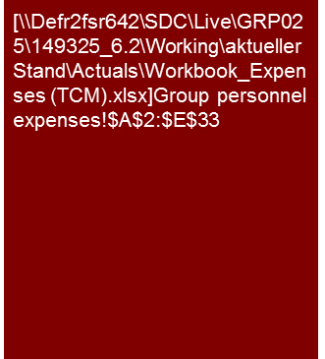
Example analysis – Personnel costs (1/2)
Expenses – Total Cost Method (historical)
From 2010 to 2012 personnel expenses increased by a CAGR of 4.7%, significantly above the increase of FTE by a CAGR of 1.1%.
Main drivers were general salary increases and the hiring of higher qualified and hence more expensive personnel.
Source: Management information; KPMG analysis

Slide 10
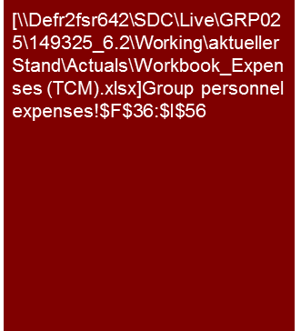
Example analysis – Personnel costs (2/2)
Expenses – Total Cost Method (historical)
Average personnel expenses per FTE increased by 5.8% in 2011 and 3.3% in 2012. This reflects normal pay rises between one and two percent, higher bonus payments in 2011 and FY effects regarding personnel in Switzerland.
Source: Management information; KPMG analysis

Slide 11
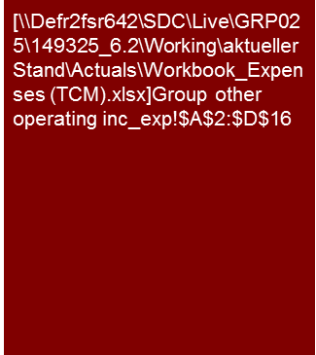
Example analysis – Other expenses
Expenses – Total Cost Method (historical)
Note: Since the report should only focus on key issues / messages, breakdowns of line items as displayed on the left should be presented in the appendix.
The table does not need any additional comments since the figures speak for themselves.
One can consider to explain e.g. the increase the development of marketing expenses with highlight boxes.
Source: Management information; KPMG analysis

Slide 12
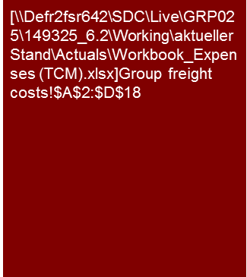
Example analysis – Other expenses outbound freight
Expenses – Total Cost Method (historical)
Outbound freight costs declined from 2010 to 2011 both in absolute terms and as a percentage of net sales due to lower freight tariffs and more central warehouse delivery, and have been fairly constant in 2012.
Source: Management information; KPMG analysis

Slide 13
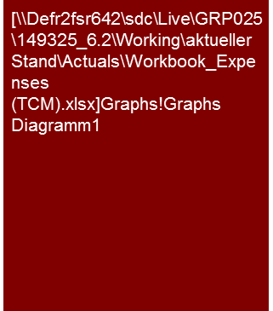
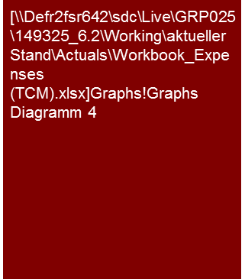
Example analysis – Composition of the cost structure
Expenses – Total Cost Method (historical)
Approximately 80-85% of the Group’s cost base (between net sales and EBITDA) is semi-variable or variable (including COGS). The main such costs being costs of goods and supplies, supplier rebates and freight charges.
The main fixed costs are personnel expenses and rent paid on warehouses.
Group – Cost breakdown 2008 – 2012
Fixed vs. variable costs 2012
Source: Management accounts; KPMG analysis
When considering the cost base of the Group between net sales and EBITDA, costs of goods and supplies and supplier discounts combined account for approximately 70% of Targets total operating cost base. This reflects the fact that the cost base of the Group is primarily variable. This proportion is projected to increase over the Business plan period due to factors mentioned on the previous page (e.g. higher sales to discounters, via Asia which carry a proportionally lower freight charge).
The main cost items management classify as variable, semi-variable and fixed between net sales and EBITDA are:
Variable: Cost of goods and supplies, supplier bonuses, discounts and rebates, winter returns, packaging;
Semi-Variable: Freight, retrospective supplier rebates (marketing allowances), expenses for agency staff, insurance costs, marketing allowances;
Fixed: Group personnel, rent and lease charges, administration costs.

Slide 14
© 2017 KPMG International Cooperative (“KPMG International”). KPMG International provides no client services and is a Swiss entity with which the independent member firms of the KPMG network are affiliated.

